Slide 1
An Attention-based Neural Network on Multiple Speaker Diarization
Kai Jyun Hung, Shao Wen Cheng, Hsie Chia Chang, Yen Chin Liao
2022 IEEE International Conference on Artificial Intelligence Circuits and Systems
Virtual & Hybrid Conference
National Yang Ming Chiao Tung University

Slide 2
Outline
Introduction
Background
Proposed Method
Experimental Results
Reference

Slide 3
Outline
Introduction
Background
Proposed Method
Experimental Results
Reference

Slide 4



Introduction
Speaker Diarization
Who spoke when?
Multiple speakers in each speech utterance
Speaker 1
Speaker
Diarization
Model
Speaker 2

Slide 5
Outline
Introduction
Background
Proposed Method
Experimental Results
Reference

Slide 6
Background
Evaluation metrics - Diarization Error Rate
Evaluation metrics in this work
Notice that some papers adopt simplified metrics
$$DER= \frac{Miss Detection+False Alarm+Overlap+Confusion}{Reference}$$
$$DER_Simplified= \frac{Confusion}{Reference}$$

Slide 7
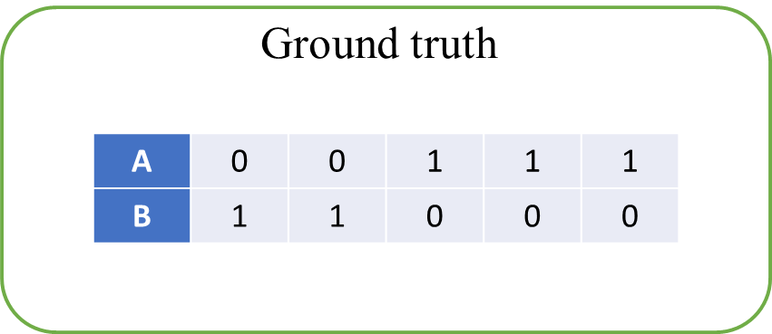
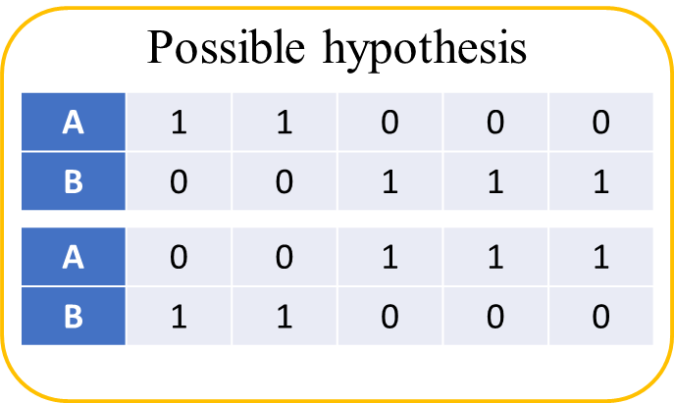
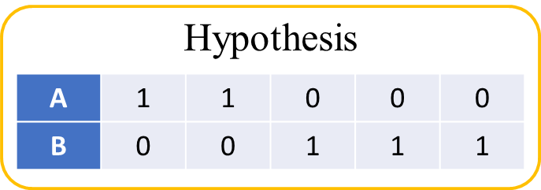
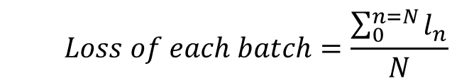
Background
Permutation-Free Objectives with Cross Entropy Loss [1]
Find minimum loss between hypothesis and all the possible combinational of ground truth
Compute Loss
$$l_{n}=y_{n}⋅\log{x_{n}}+\left(1−y_{n}\right)⋅\log\left(1−x_{n}\right)$$
$$Loss of each batch=\frac{\sum_{0}^{n=N}{l_{n}}}{N}$$
$x_{n} is hypothesis n,y_{n}$ $is ground truth$ $n$
Permutation

Slide 8
Outline
Introduction
Background
Proposed Method
Experimental Results
Reference

Slide 9

Proposed Method
Data Preprocessing
Pre-Emphasis
Short-Time Fourier
Transform [2]
Log-Mel
Filter Bank [3]
Speech Utterance
*.wav with sample rate 8000
Splice
Subsampling
Diarization Model
Concatenate previous and subsequent 7 frames
Subsample by a factor of 10

Slide 10
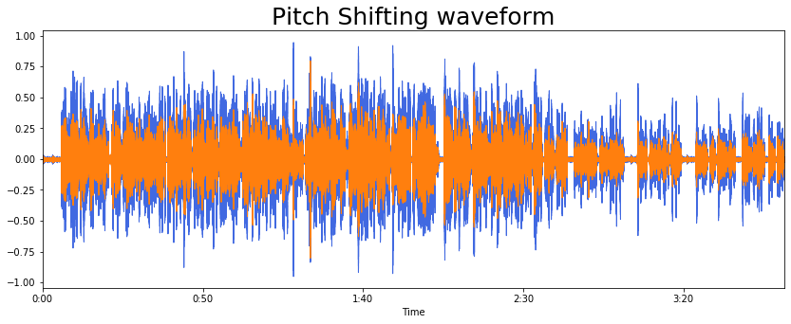
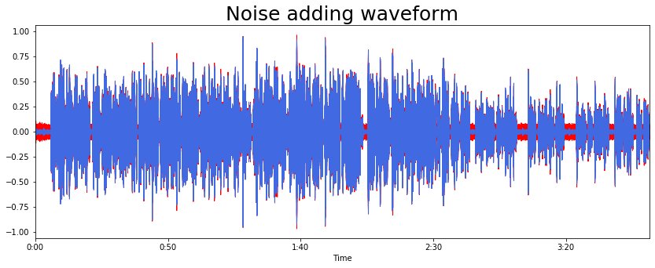
Proposed Method
Data Augmentation
Pitch shifting
Noise adding
SpecAugment [4]

Slide 11
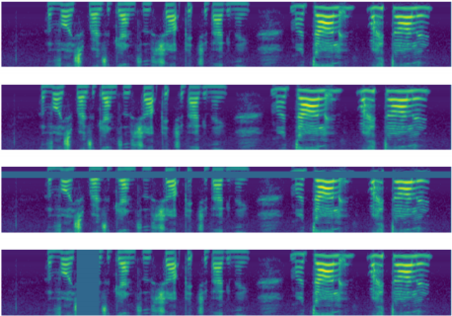
Proposed Method
Data Augmentation
Pitch shifting
Noise adding
SpecAugment [4]
Original
spectrum
frequency
Time warp
Frequency masking
Time
masking
Time

Slide 12
Proposed Method
Model Structure [5]
Input
Feature
Hypothesis
Decoder
Layer
Encoder
Layer
Transformer Encoder

Slide 13
Proposed Method
Data Postprocessing
Utterance
Reconstruction
Median
Filter
Threshold
Selection
Hypothesis
Diarization Result

Slide 14

Proposed Method
Utterance Reconstruction (1/4)
Split the speech utterance before inference due to length limited. Then concatenate the result by computing the loss of overlapping part.
overlap
3rd Hypothesis
Diarization Model
2nd Hypothesis
Speech Utterance
1st Hypothesis

Slide 15
Proposed Method
Utterance Reconstruction (2/4)
Split the speech utterance before inference due to length limited. Then concatenate the result by computing the loss of overlapping part.
1st Hypothesis
1st Overlap
overlap
2nd Hypothesis permutation 1
2nd permutation overlap 1
2nd Hypothesis
Permutation
2nd Hypothesis permutation 2
2nd permutation overlap 2

Slide 16
Proposed Method
Utterance Reconstruction (3/4)
Split the speech utterance before inference due to length limited. Then concatenate the result by computing the loss of overlapping part.
BCE Loss
Overlap part
1st Hypothesis
1st Overlap
2nd Hypothesis permutation 1
2nd permutation overlap 1
2nd Hypothesis
Permutation
2nd Hypothesis permutation 2
2nd permutation overlap 2

Slide 17
Proposed Method
Utterance Reconstruction (4/4)
Split the speech utterance before inference due to length limited. Then concatenate the result by computing the loss of overlapping part.
Overlap part
1st Hypothesis
1st Overlap
Minimum loss
2nd Hypothesis permutation 1
2nd permutation overlap 1
2nd Hypothesis
Permutation
2nd Hypothesis permutation 2
2nd permutation overlap 2

Slide 18
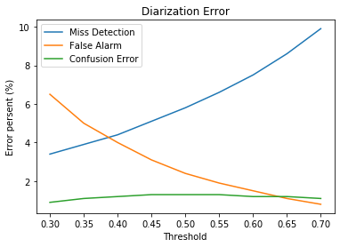
Proposed Method
Threshold Choosing
Select different threshold with binary search.
The lower the threshold, the higher the false alarm.
The higher the threshold, the higher the miss detection.
The relationship between threshold and confusion error is small.

Slide 19
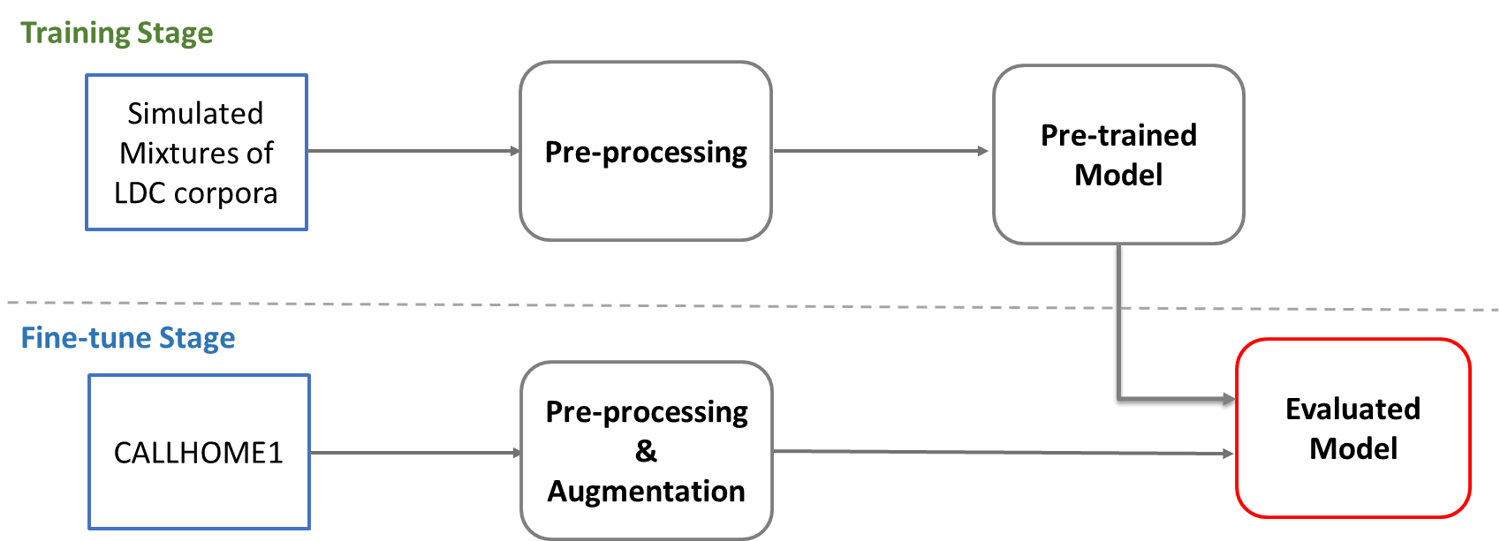
Proposed Method
Training of Diarization System

Slide 20
Outline
Introduction
Background
Proposed Method
Experimental Results
Reference

Slide 21
Experimental Results
Experimental Data
Training set:
Simulated Mixtures [6] of LDC Corpora [7]
Fine-tune set:
Subset of 2000 NIST Speaker Recognition Evaluation (CALLHOME) [8]
Fine-tune set:
Subset of 2000 NIST Speaker Recognition Evaluation (CALLHOME)

Slide 22
Experimental Results
Experimental Results
Model | Pre-trained data | DER
Proposed convolution model | 100000 simulated mixtures | 9.47%
Proposed linear model |  | 9.12%
SA-EEND [5] |  | 9.54%
SA-EEND-EDA [9] | 400000 simulated mixtures | 8.07%

Slide 23
Outline
Introduction
Background
Proposed Method
Experimental Results
Reference

Slide 24
Reference
[1] D. Yu, M. Kolbæk, Z.-H. Tan, and J. Jensen, “Permutation invariant trainingof deep models for speaker-independent multi-talker speech separation,” inIEEEInternational Conference on Acoustics, Speech and Signal Processing (ICASSP),2017, pp. 241–245.
[2] J. Allen, “Short term spectral analysis, synthesis, and modification by discretefourier transform,”IEEE Transactions on Acoustics, Speech, and Signal Process-ing, vol. 25, no. 3, pp. 235–238, 1977.
[3] S. S. Stevens, J. Volkmann, and E. B. Newman, “A scale for the measurement ofthe psychological magnitude pitch,”Journal of the Acoustical Society of America,vol. 8, pp. 185–190, 1937.
[4] D. S. Park, W. Chan, Y. Zhang, C. C. Chiu, B. Zoph, E. D. Cubuk and Q. V. Le. SpecAugment: A Simple Data Augmentation Method for Automatic Speech Recognition. 2019.
[5] Y. Fujita, S. Watanabe, S. Horiguchi, Y. Xue, and K. Nagamatsu, “End-to-endneural diarization: Reformulating speaker diarization as simple multi-label classi-fication,”ArXiv, vol. abs/2003.02966, 2020.

Slide 25
Reference
[6] Y. Fujita, N. Kanda, S. Horiguchi, K. Nagamatsu, and S. Watanabe, “End-to-end neural speaker diarization with permutation-free objectives,” in Proc. Interspeech, 2019, pp. 4300–4304.
[7] Linguistic Data Consortium. [Online]. Available: https://www.ldc.upenn.edu/
[8] Przybocki, Mark, and Alvin Martin, “2000 NIST Speaker Recognition Evaluation LDC2001S97,” Web Download, 2001, Philadelphia: Linguistic Data Consortium.
[9] S. Horiguchi, Y. Fujita, S. Watanabe, Y. Xue, and K. Nagamatsu, “End-to-end speaker diarization for an unknown number of speakers with encoder-decoder based attractors,” ArXiv, 2020.

